Slide 1

paul Withers
ICS Developer, Intec Systems
OpenNTF Board Member
IBM Lifetime Champion
@paulswithers
Notes Developer
XPages Developer
Java Developer
Microservices Developer

Slide 2

John Jardin
CTO, Agilit-e and Ukuvuma
IBM Champion (Cloud and ICS)
Guy who head bangs to Chainsmokers
@JohnJardinCodes
Integration & Cloud Architect
XPages Developer
DevOps Engineer
AI Programming

Slide 3
agenda
Introduction
Container Clustering
ReactJS
Domino as a datastore and API Gateway
What about scheduled tasks?
Microservices For Domino

Slide 4
introduction

Slide 5
Change your thinking
Pros
Greater flexibility
Best of breed
Increased standardisation
Cons
Code for failure
Step outside comfort zone
More integration points

Slide 6
Domino
Kubernetes Cluster
NSF Catalog
Agilit-e
NSF Store
NSF Store
NSF
Store
Node-RED
Web Socket Server
API Gateway
(OSGi Java Servlet)
React App
Istio

Slide 7
Container Clustering

Slide 8
A Different Approach
Don’t build 3rd party technologies into Domino
Have these technologies exist as a sidecar to a Domino environment
Each technology or service existing independently as a container
All communication occurs using APIs

Slide 9
A Different Approach Cont.
Example 1: ReactJS User Interface
Develop React UI using NodeJS and Webpack
In Domino, create API Endpoints for all relevant calls or use DAS
Deploy React App as a standalone container
Example 2: Web Socket Server
Create Web Socket Server using socket.io and NodeJS
In Domino, include socket.io for client-side communication
Create Web Socket events for all relevant communication
Deploy Web Socket Server as standalone container

Slide 10
Container Clustering
Cluster all relevant containers using Kubernetes
Run Kubernetes as a sidecar to your Domino environment
IBM Cloud Private provides enterprise-level container management using Kubernetes
Minikube can be used for development and testing environments (low availability)
Inject new services and containers into cluster as and when needed
Manage integration, security, testing and more with Istio

Slide 11
Benefits of Container Clustering
High availability
Seamless disaster recovery
Horizontal and vertical scaling
Continuous delivery
No downtime during updates and upgrades
CPU and Memory can be assigned and managed per container/container group

Slide 12
ReactJS

Slide 13
What is reactJS
A JavaScript library for building user interfaces
React is NOT a framework
React is the “V” of MVC (Model/View/Controller)
HTML is placed in JavaScript classes to create Web Components
This is similar to Custom Controls in XPages
React makes use of a Virtual DOM and Diffing

Slide 14
Platform Agnostic
React exists as a platform-agnostic solution
Webpack and Babel compile React to a single JS file
The ”create-react-app” module provides all required build tools
A typical React dev environment:
Atom/VS Code (Editor)
NodeJS
ExpressJS
Webpack

Slide 15
Domino as a datastore and api gateway

Slide 16
REST VS API
API-first approach means
Greater control
More planning up-front
Longer initial development lifecycle
Increased portability
Better separation between database and interface
Easier extensibility into other systems
Code for failure and “bad data” – ON BOTH SIDES
Missing parameters
Invalid enums

Slide 17
REST VS API CONT.
Security considerations
How to restrict access to apps: API key, OAuth?
Use header / query params correctly
Secure e.g. scheduled endpoints differently
Additional logging of transactions?
Be careful what you expose
Should your “status” field be editable
Or just set via workflow methods

Slide 18
REST PERFORMANCE
REST = stateless, servlet = stateful
Cache with…
Notes document
ConcurrentHashMap (think applicationScope)
Google Guava Caches (better management)
Cache Server (e.g. memcache, Ehcache)

Slide 19
documentation
Swagger / Open API Specification is standard
Swagger Editor online, local node.js app or Docker
OpenAPI 3.0 released July 2017
Swagger UI allows testing against actual server
Swagger mock server can be created for UI dev

Slide 20
Creating a swagger definition
Write as YAML or JSON
YAML – no quotes around strings, no commas, no curly braces
operationIds can be added
If used, required on all for that path
Use enums for options
OpenAPI 3.0 allows examples, but clarify and add value
“Framework for good documentation”, does not guarantee good documentation

Slide 21
http Request Types
GET – Read data (No body data allowed)
POST – Submit data (Read/Write)
PUT – Replacing entire document data
PATCH – Minor update to existing data
PATCH not enabled by default on Domino
DELETE – Deleting Records (No body data allowed)

Slide 22
HTTP status codes
1xx – Received and understood, stand by…
2xx – Received, understood and accepted
3xx – Redirecting
4xx – You did something wrong!
5xx – We did something wrong!
See Wikipedia

Slide 23
http status codes CONT.
200 – OK
202 – Accepted for processing
302 – URL found but server is redirecting
400 – Bad request
401 – Unauthorised
403 – Forbidden
404 – Not found
405 – Method not allowed
500 – Internal server error

Slide 24
What about scheduled tasks?

Slide 25
API + node-red = flexibility
API
XAgent / SmartNSF / or REST endpoint
Use Xots for background processing
Node-RED – Installable alongside Domino with NodeJS
Scheduling of flows that includes Web APIs
Other schedulers would work, as long as they can call a Web API

Slide 26
Node-red
An integration tool for wiring together APIs and online services
Available on IBM Cloud, local node.js app or Docker
Note: Docker containers not aware of host’s “localhost” or other containers
Schedule tasks via Inject node (or Big Timer)
Additional nodes for e.g. Watson Services, Connections
Basic authentication can be set
Flows can be imported / exported as JSON
Can also be used for end-to-end test of APIs

Slide 27
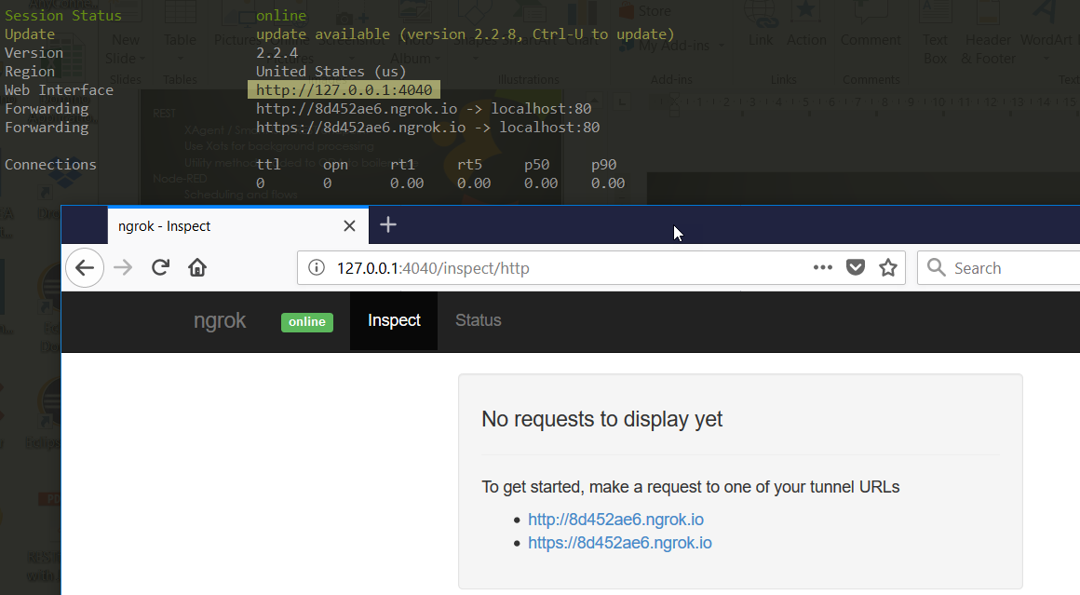
Integrating private / public
“Private” needs to be made “public”
ngrok provides secure tunnels
cmder is a good console emulator for Windows

Slide 28
Microservices For Domino

Slide 29
Microservice Patterns
Micro-Functions
Breakdown functions into re-usable/modular code blocks
Each function should do one thing and do it well
Simplify and optimize the code within each function
A function shouldn’t contain more than 80-100 lines of code
Develop ”Pure Functions” whenever possible
Easier to test for “code coverage”

Slide 30
Microservice Patterns Cont.
Micro-Services
Define which micro-functions can become services to 3rd party platforms and applications
Create API Endpoints that trigger your micro- functions
Ensure a strong security layer for 3rd parties to interface with before triggering your services

